Slide 1
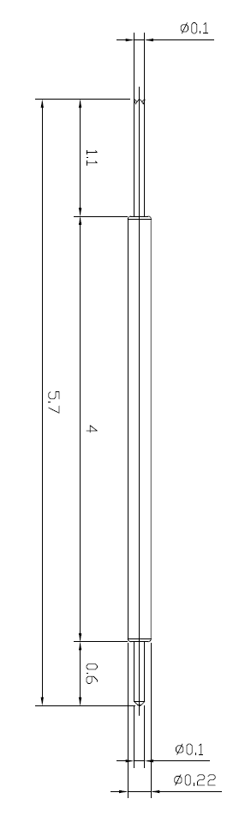
※ General POGO pin – 5.7mm / 0.3P
IVB-DCR-570-022-A222-00
Pitch | 0.5mm
Total Length | 5.7mm
Use Length | 5.2mm
Use Stroke | 0.65mm
Spring Force at Use Stroke | 10gf at 0.65mm Stroke
Operating Temperature | -40 to 150°C
DC Resistance | 150.0mΩ at 0.65mm stroke
Current Rating | 0.5A (Continuous)
Self Inductance | 1.58 nH
Bandwidth @ -1dB | 7.2 GHz
Top Plunger | BeCu / Au over Ni
Bottom Plunger | BeCu / Au over Ni
Barrel | BeCu / Au over Ni
Spring | Stainless Steel / Au
Insertion Life | 100,000 cycles at 0.65mm Stroke

